Slide 1
DATA-DRIVEN OPTIMIZATION
Student Academic Performance
Through Study Habits Analysis
MartLabs|AI & Machine Learning • Mbeya University of Science and Technology (MUST)
Business Intelligence Analysis • Group 9
Participants: Adili S. Edward | Joseph M. Nzije | Carol F. Kika | Frank L. Mlyakalamu | Athanas J. Kayombo
Supervisor: [Ipyana] • Presentation date: [14/08/2026]
Turning student data into actionable academic insights.

Slide 2
Introduction / Background
Why this analysis matters
CONTEXT
Student performance is a measurable outcome of a complex learning environment.
Analytical goal
Move from general assumptions about study habits to evidence-based observations from the student dataset.
• Students exhibit different study patterns, attendance levels and learning circumstances.
• Institutions already collect academic and behavioral information, but it is not always converted into actionable insight.
• Data analytics can reveal patterns, compare groups and support targeted academic interventions.
• The project therefore uses student-level data to examine factors associated with final examination performance.
Decision value
Identify performance signals that can inform academic monitoring, support and resource prioritization.
GROUP 9 • Data-Driven Student Performance Analysis
2

Slide 3
Problem Statement
The research gap addressed by the project
The core problem
• Different students have different study habits and academic behaviors.
• Some behaviors are associated with stronger or weaker academic outcomes.
• Traditional support can miss patterns hidden across multiple student variables.
• Without analysis, it is difficult to prioritize students and interventions using evidence.
RESEARCH NEED
Identify meaningful relationships between study habits and academic performance, then translate those findings into evidence-based support actions.
Data → Pattern → Insight → Intervention
GROUP 9 • Data-Driven Student Performance Analysis
3

Slide 4
Objectives
What the analysis was designed to answer
GENERAL OBJECTIVE
Analyze student study habits and identify data-driven factors associated with academic performance.
Specific objectives
01
Analyze student academic performance.
02
Examine major study habits and behavioral patterns.
03
Investigate relationships between study habits and academic outcomes.
04
Identify factors associated with higher academic performance.
05
Develop evidence-based recommendations for improving academic performance.
GROUP 9 • Data-Driven Student Performance Analysis
4

Slide 5
Research Questions
Questions directly aligned to the analysis workflow
1
What is the relationship between study hours and academic performance?
2
Does attendance influence academic performance?
3
Which study-related factors are most strongly associated with final exam scores?
4
Do internet access and part-time employment correspond to different performance levels?
5
How can data-driven insights be used to identify and support students at risk?
GROUP 9 • Data-Driven Student Performance Analysis
5

Slide 6
Dataset Description
Actual structure reported by the uploaded notebook
1,000
12
5
6
Records
Columns after loading
Numerical variables
String variables
Target / outcome
Key numerical variables
final_exam_score and final_grade
study_time_hours • attendance_percent • sleep_hours • previous_grade • final_exam_score
Key categorical variables
gender • parental_education • internet_access • extracurricular_activities • part_time_job • final_grade
Dataset source name used in notebook: student_performance_dataset.csv
GROUP 9 • Data-Driven Student Performance Analysis
6

Slide 7
Data Cleaning & Preprocessing
Raw data → cleaning → transformation → analysis-ready data
01
02
03
04
05
RAW DATA
QUALITY CHECK
CLEAN
TRANSFORM
DERIVE
1,000 rows 12 columns
102 missing 0 duplicates
Mode imputation for parental education
Study & attendance categories
Pass / At Risk score change
Missing-value treatment
Parental education had 102 missing values (10.2%). Because it is categorical, the notebook filled missing entries using the mode. After cleaning, all columns contained 0 missing values.
Derived features: study-time bands, attendance bands, performance_status and score_change.
GROUP 9 • Data-Driven Student Performance Analysis
7

Slide 8
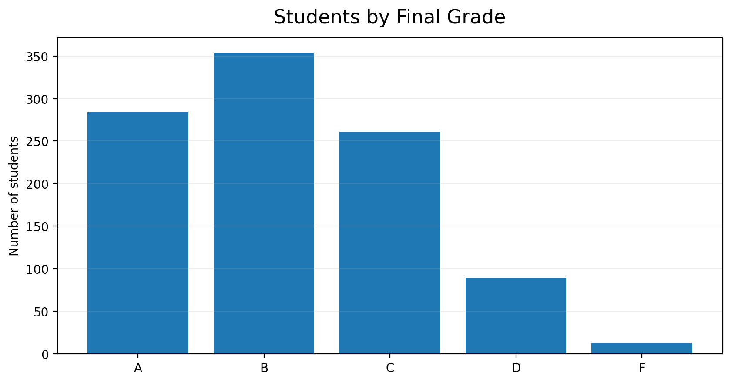
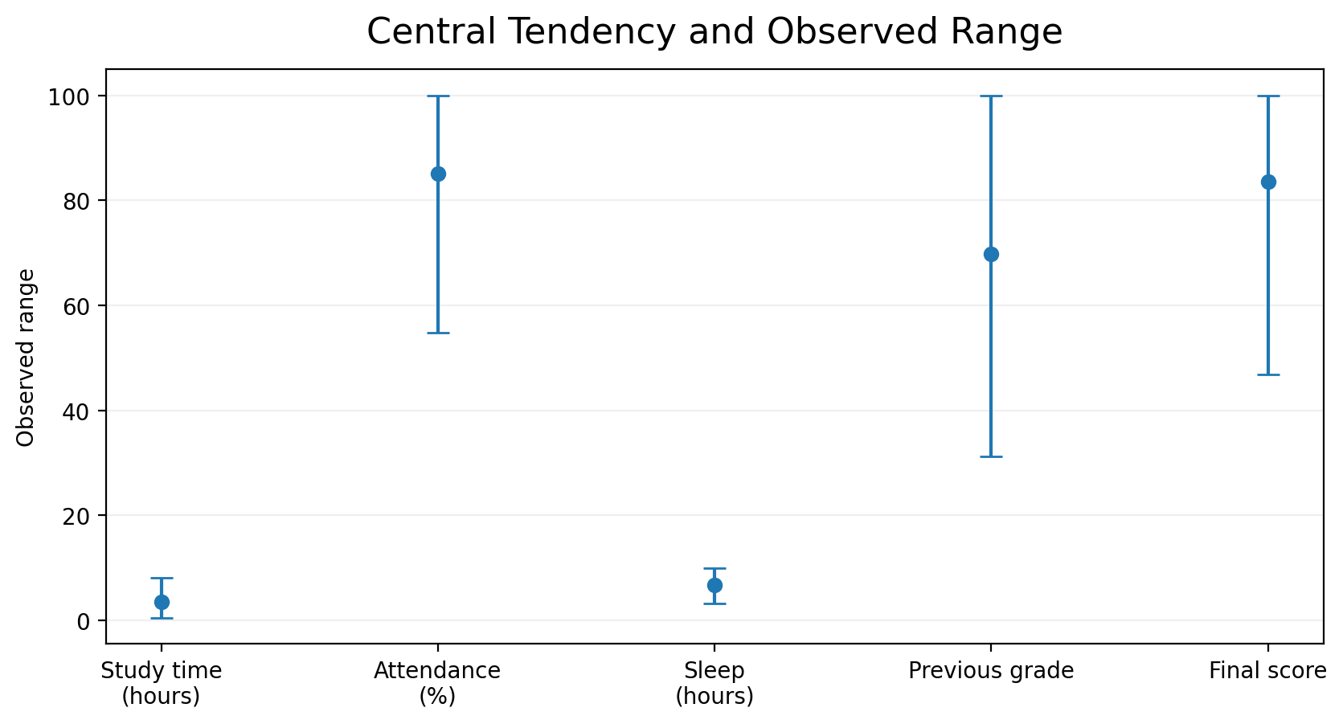
Exploratory Data Analysis
Performance distribution and descriptive profile
Key insight
The most common final grade is B (354 students), followed by A (284) and C (261). D and F together account for 101 students classified as At Risk.
GROUP 9 • Data-Driven Student Performance Analysis
8

Slide 9
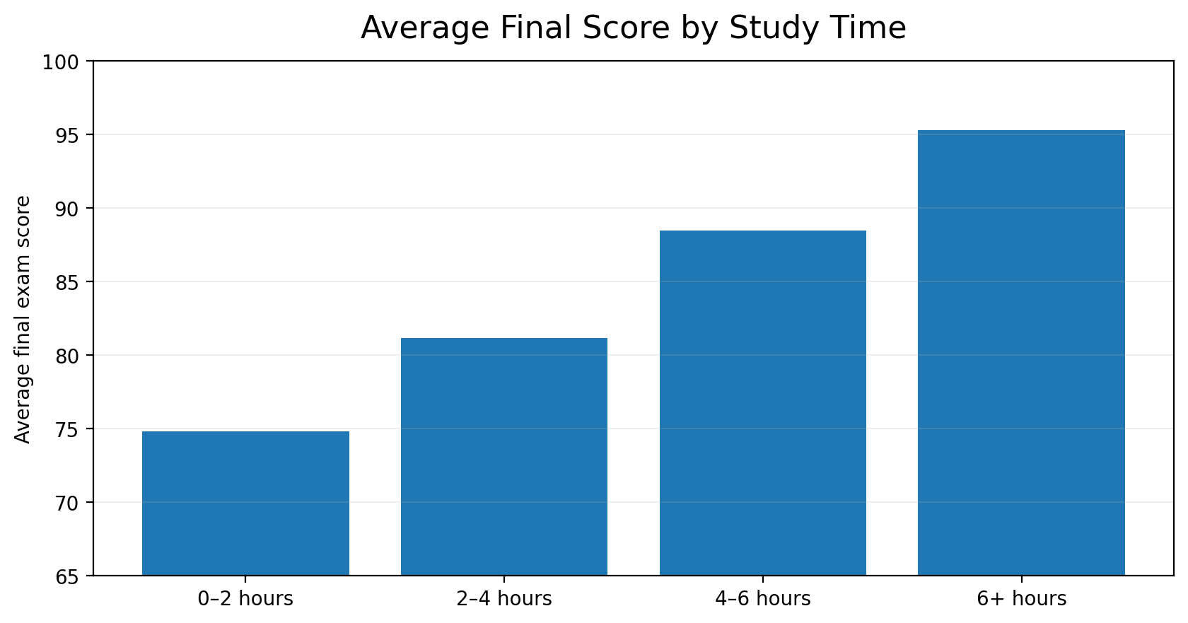
Study Hours Analysis
A clear positive pattern across study-time categories
r = 0.568
Correlation with final score
0–2 hours → 74.79
6+ hours → 95.32
Observed gap: 20.53 points
Interpretation: study time has the strongest observed linear association with final score among the variables examined. The analysis does not establish causation.
GROUP 9 • Data-Driven Student Performance Analysis
9

Slide 10
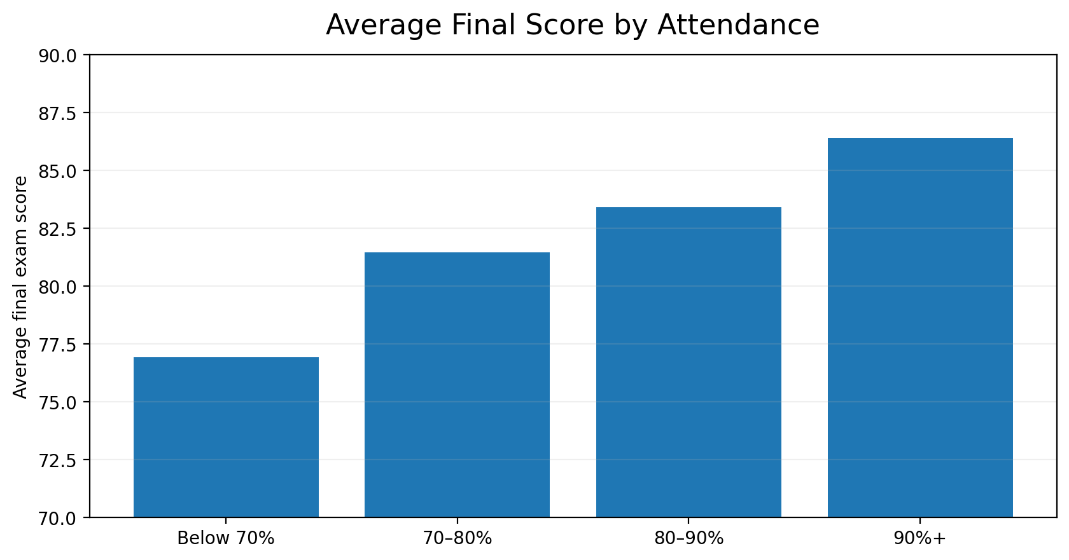
Attendance Analysis
Higher attendance bands correspond to higher average scores
r = 0.262
Correlation with final score
Below 70% → 76.91
90%+ → 86.41
Observed gap: 9.50 points
Interpretation: attendance shows a positive, but weaker, association with final score than study time or previous grade.
GROUP 9 • Data-Driven Student Performance Analysis
10

Slide 11
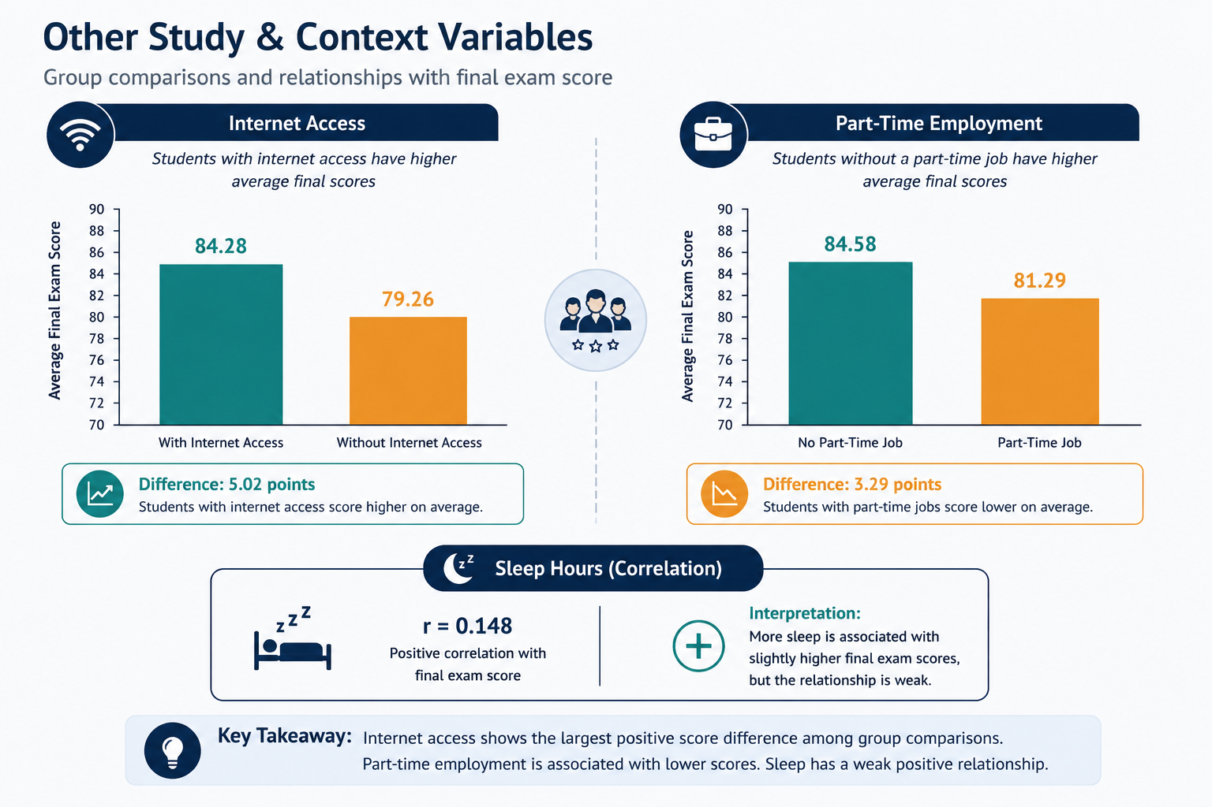
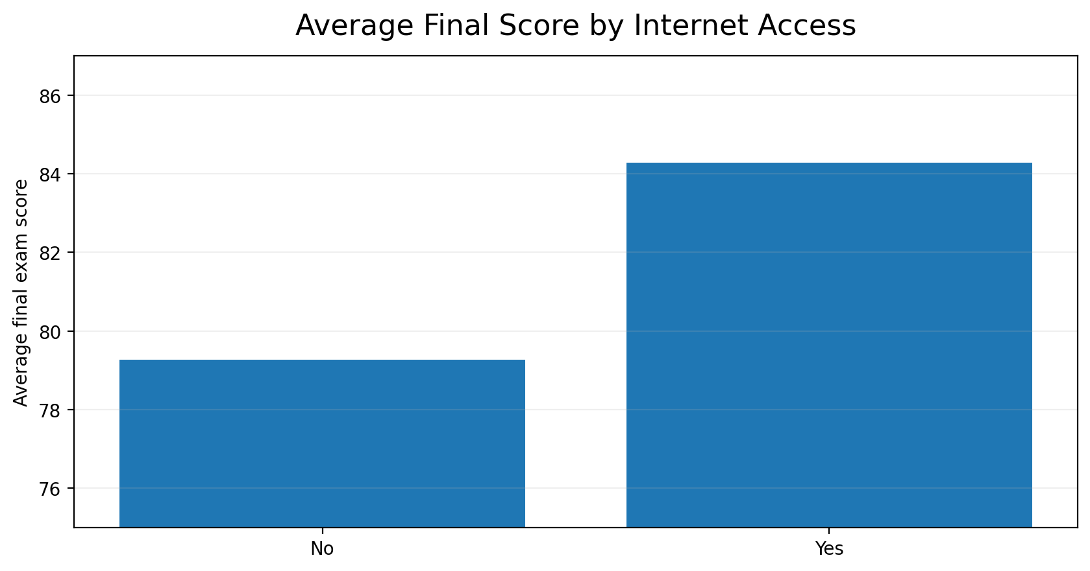
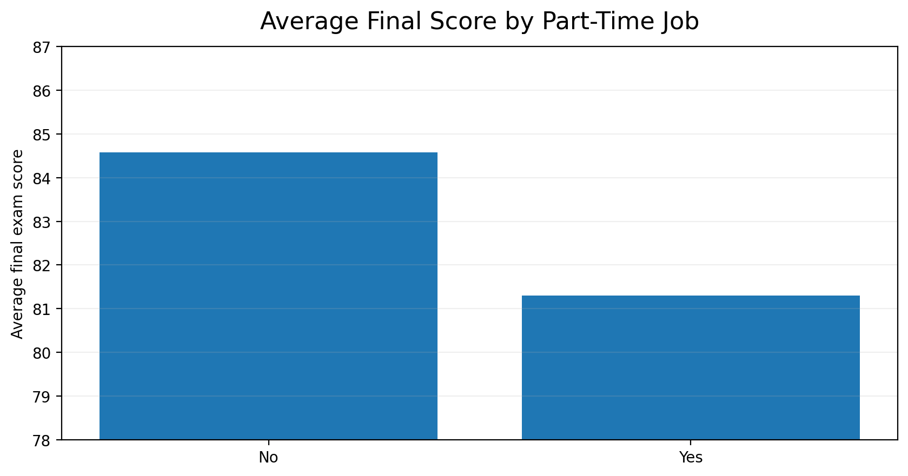
Other Study & Context Variables
Additional performance signals present in the dataset
Internet access
Part-time employment
Yes: 84.28 • No: 79.26 • Gap: 5.02 points
No job: 84.58 • Job: 81.29 • Gap: 3.29 points
Sleep is positively correlated with final score at r = 0.148, which is weaker than the relationships for study time, previous grade and attendance.
GROUP 9 • Data-Driven Student Performance Analysis
11

Slide 12
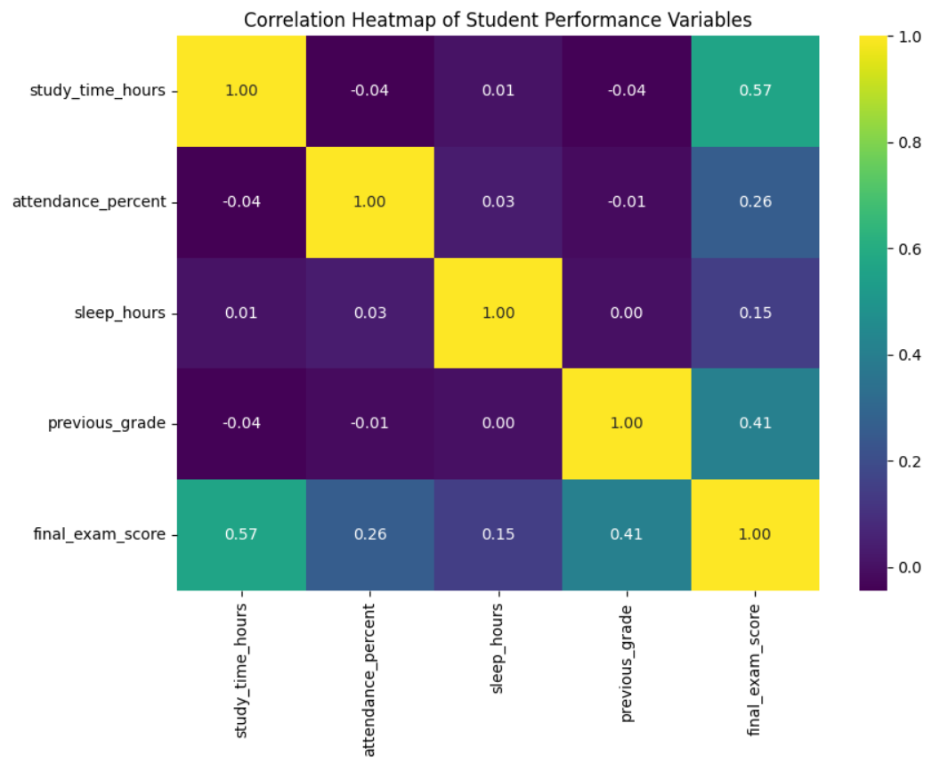
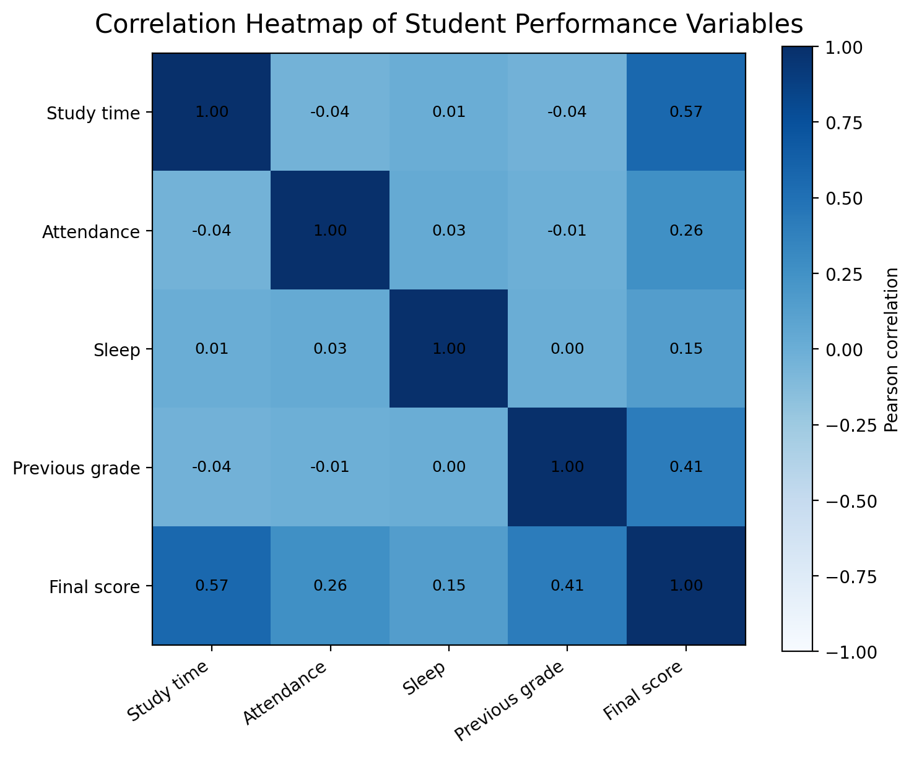
Correlation Analysis
Pearson correlations reported by the notebook
Strongest positive relationships with final score
Study time
0.568
Previous grade
0.406
Attendance
0.262
Sleep
0.148
Interpretation
The matrix shows association, not causation. Statistical significance testing was not reported in the notebook, so significance claims are intentionally not made.
GROUP 9 • Data-Driven Student Performance Analysis
12

Slide 13
Statistical / Analytical Findings
Finding → evidence → interpretation
Study time
r = 0.568
Strongest observed positive linear association with final score.
Previous grade
r = 0.406
Prior achievement is positively associated with final performance.
Attendance
r = 0.262
Higher attendance bands have higher average final scores.
Internet access
84.28 vs 79.26
Students with internet access have a higher group average.
Part-time job
81.29 vs 84.58
Students with a part-time job have a lower group average.
GROUP 9 • Data-Driven Student Performance Analysis
13

Slide 14
Key Insights Dashboard
Management-ready snapshot of the analyzed cohort
1,000
83.54
3.57 h
85.09%
Total students
Avg final score
Avg study time
Avg attendance
89.90%
10.10%
95.32
0.568
Pass rate
At-risk rate
Best study category avg
Strongest correlation
Additional KPI: internet access rate = 85.40% • average score change = +13.80 points
Note: “Strongest correlation” refers to the largest Pearson correlation with final_exam_score among the numerical variables analyzed.
GROUP 9 • Data-Driven Student Performance Analysis
14

Slide 15
Data-Driven Recommendations
Actions directly connected to observed patterns
FOR STUDENTS
FOR EDUCATORS
FOR INSTITUTIONS
• Develop structured study schedules, especially for low study-time groups.
• Maintain regular attendance and monitor attendance before it falls below 70%.
• Identify D/F students early and provide targeted academic support.
• Monitor study-time and attendance indicators alongside academic results.
• Use the BI dashboard for continuous performance monitoring.
• Provide digital learning resources to students without internet access.
• Offer flexible academic support for students with part-time jobs.
Evidence basis: strongest signals are study time, previous grade, attendance, internet access and part-time employment.
GROUP 9 • Data-Driven Student Performance Analysis
15

Slide 16
Proposed Optimization Framework
A repeatable analytics-to-intervention cycle
Student Data
Performance Analysis
↓
↓
Data Collection
Personalized Recommendations
↓
↓
Data Cleaning
Academic Intervention
↓
↓
Exploratory Analysis
Performance Monitoring
↓
Pattern Identification
Continuous loop
Performance monitoring feeds the next cycle of data collection and intervention.
GROUP 9 • Data-Driven Student Performance Analysis
16

Slide 17
Limitations
Important boundaries on interpretation
!
The analysis is based on a dataset of 1,000 student records; representativeness beyond this dataset is not established.
!
Parental education had 102 missing values and was imputed using the mode.
!
The notebook does not document statistical significance tests, so significance claims are not made.
!
Correlation and group differences describe association; they do not establish causal effects.
!
The notebook does not provide evidence of a randomized or longitudinal causal design.
!
Some student-context variables may not be captured, limiting the completeness of the explanation.
GROUP 9 • Data-Driven Student Performance Analysis
17

Slide 18
Future Work
How the project can evolve from descriptive analytics to predictive support
Larger datasets
Machine learning
Early-warning system
Validate patterns across more cohorts and programs.
Build performance classification or prediction models.
Flag students using multiple risk indicators.
Personalized recommendations
Interactive dashboard
Real-time monitoring
Translate patterns into individualized support plans.
Allow lecturers and administrators to drill into trends.
Update academic risk indicators as new data arrives.
Priority: extend the current evidence base before making automated high-stakes decisions.
GROUP 9 • Data-Driven Student Performance Analysis
18

Slide 19
CONCLUSION
What did the analysis discover?
Study time showed the strongest observed relationship with final exam score (r = 0.568), followed by previous grade (r = 0.406) and attendance (r = 0.262). Students in the 6+ hour study category averaged 95.32, compared with 74.79 for the 0–2 hour category.
Why does it matter?
The findings provide an evidence base for targeted academic support. With 101 students classified as At Risk, institutions can use study-time, attendance and performance indicators to prioritize monitoring and intervention.
Turning student data into actionable academic insights.

Slide 20
THANK YOU
Questions & Discussion
“Turning student data into actionable academic insights.”
MartLabs • MUST • Group 9
Adili S. Edward | Joseph M. Nzije | Carol F. Kika | Frank L. Mlyakalamu | Athanas J. Kayombo

